Slide 1
Complexity: performance

Slide 2
Analytics
Training
Deployment

Slide 3
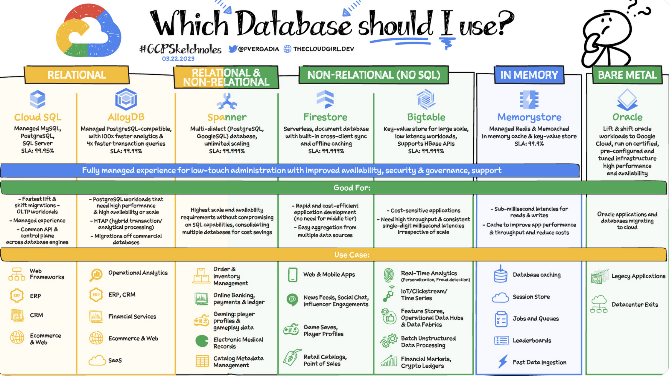
Analytics
Efficient databases

Slide 4
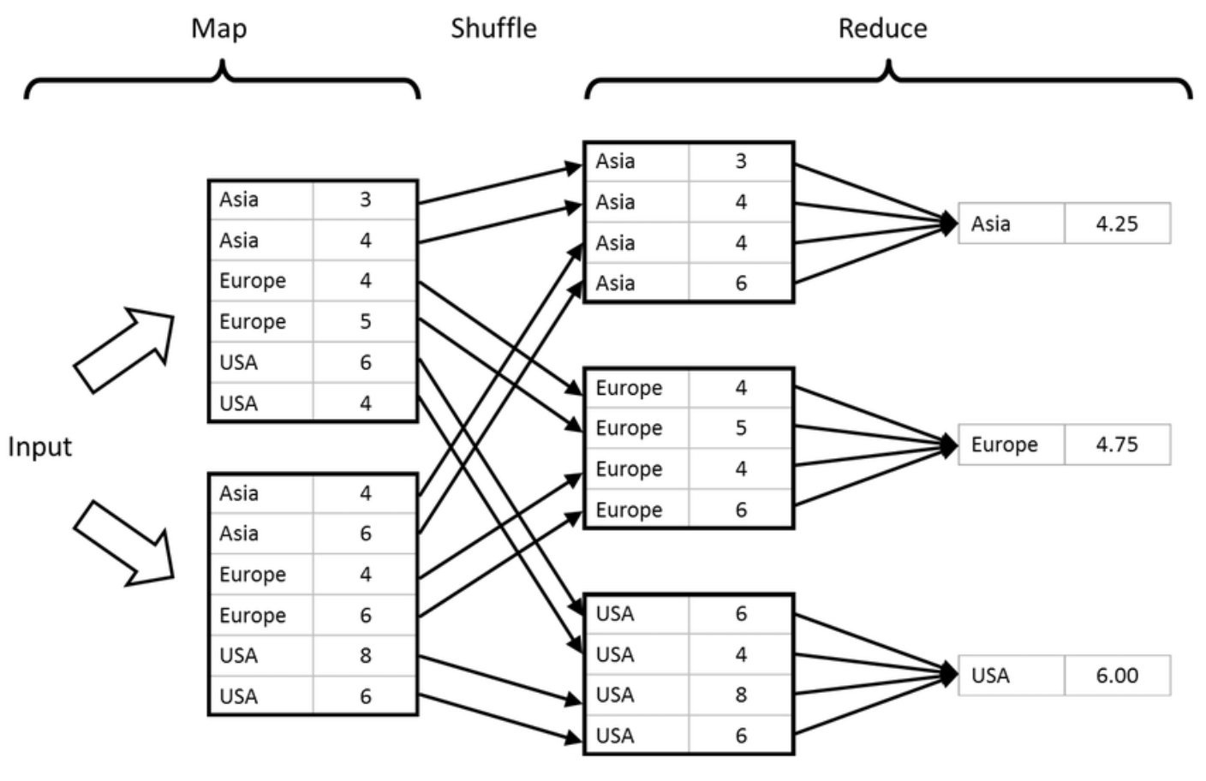
Analytics
Distributed computing

Slide 5
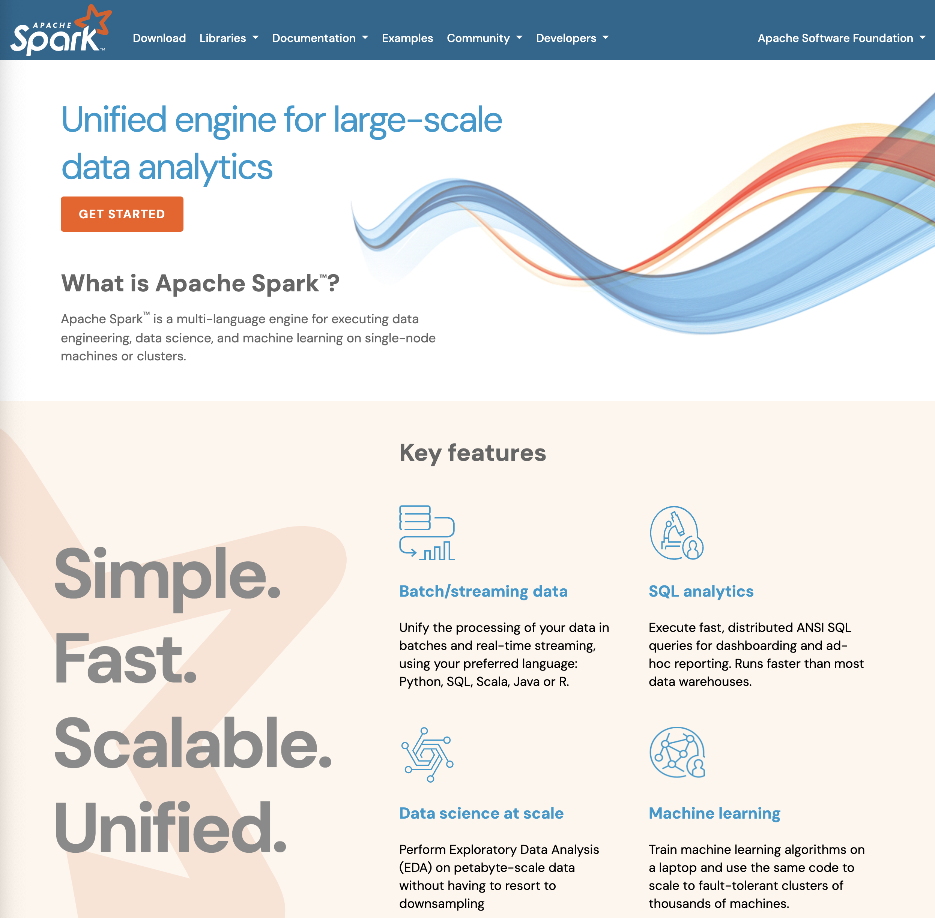
Analytics
Clusters

Slide 6
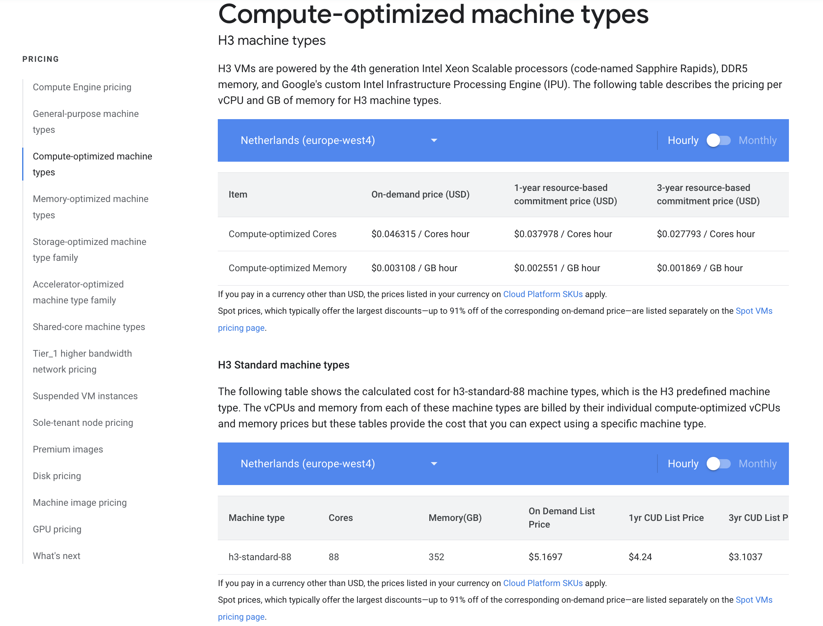
Training
Better servers

Slide 7

Training
Use earlier versions of models (checkpoints)

Slide 8
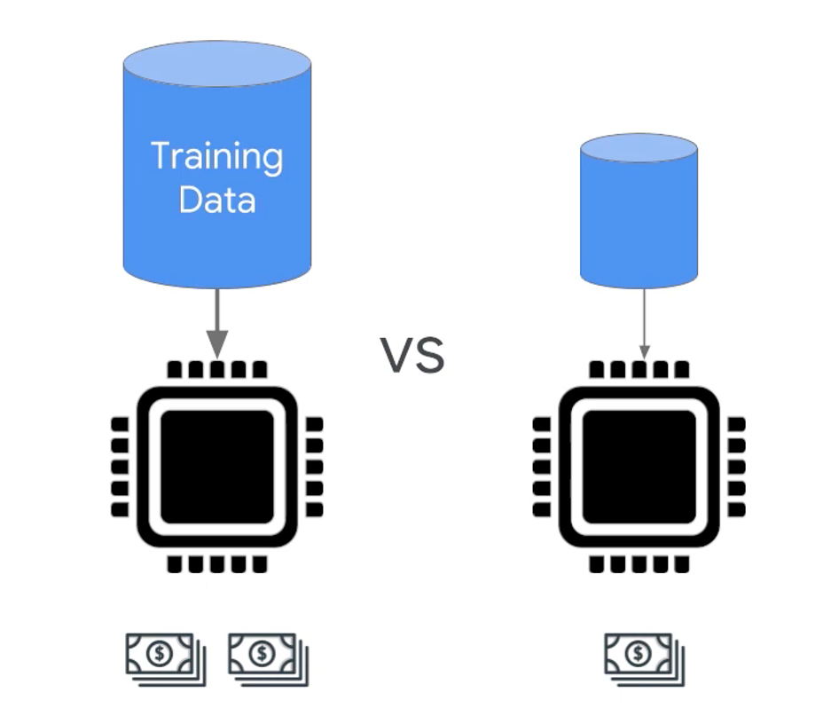
Training
Optimize the size of the training set

Slide 9
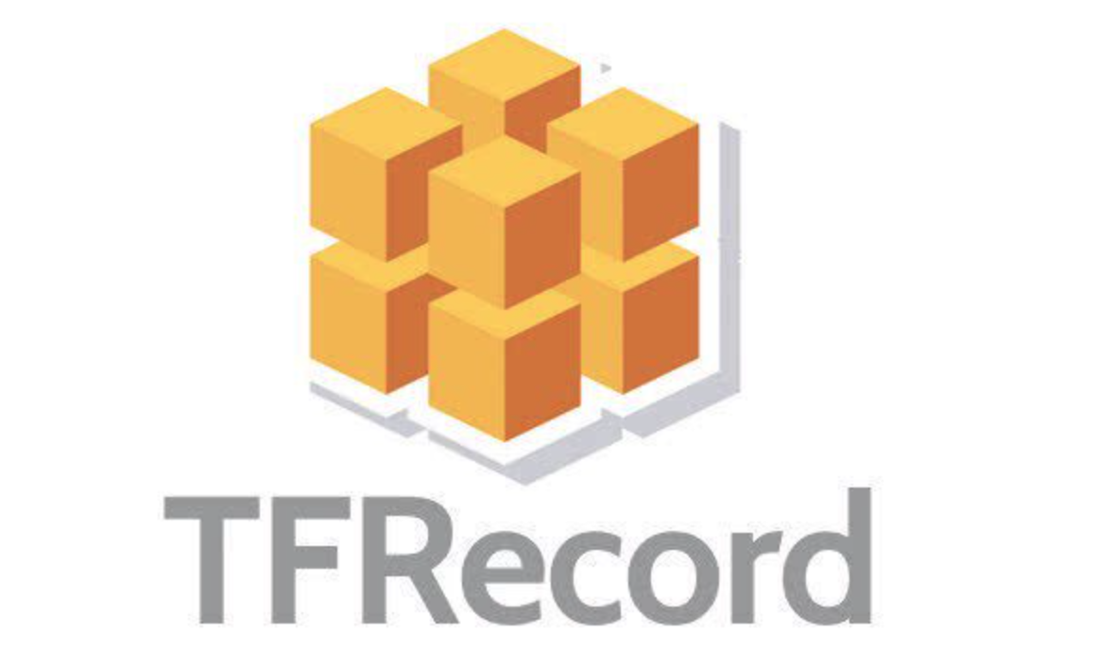
Training
Optimize the format of the training set (so as to use, for example, Tensor Processor Units)

Slide 10
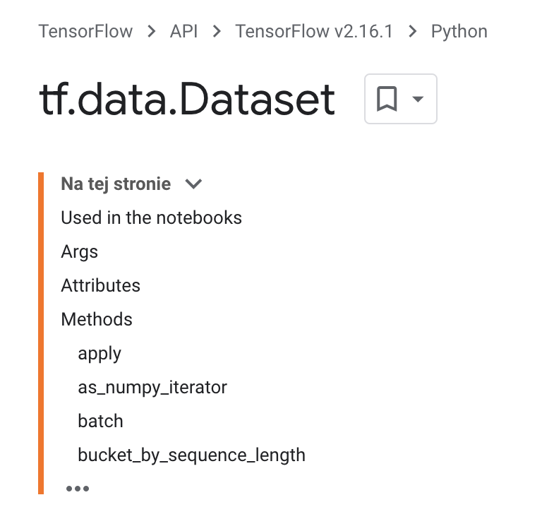
Training
Optimize the training set delivery pipeline

Slide 11
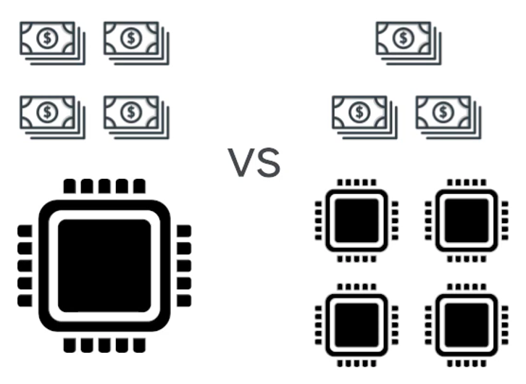
Training
Optimize the architecture

Slide 12
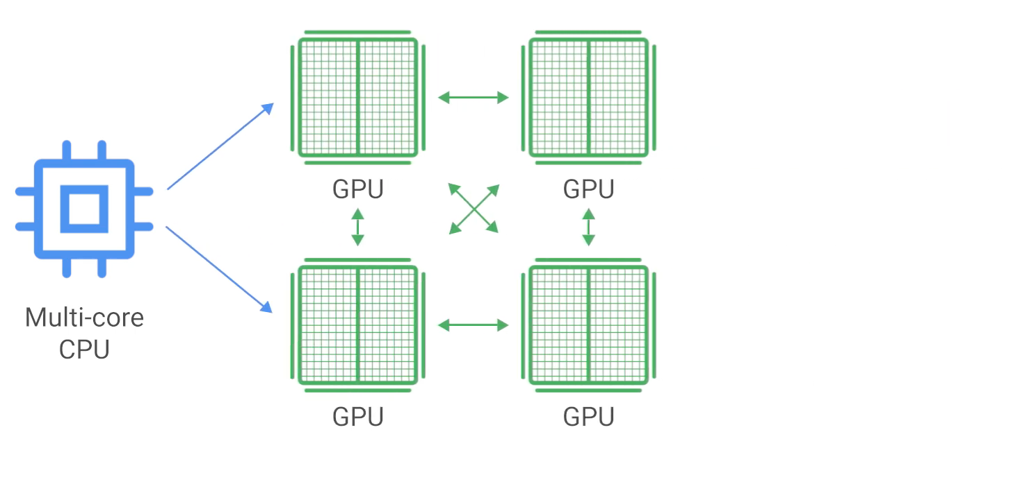
Training
Take advantage of distributed training

Slide 13
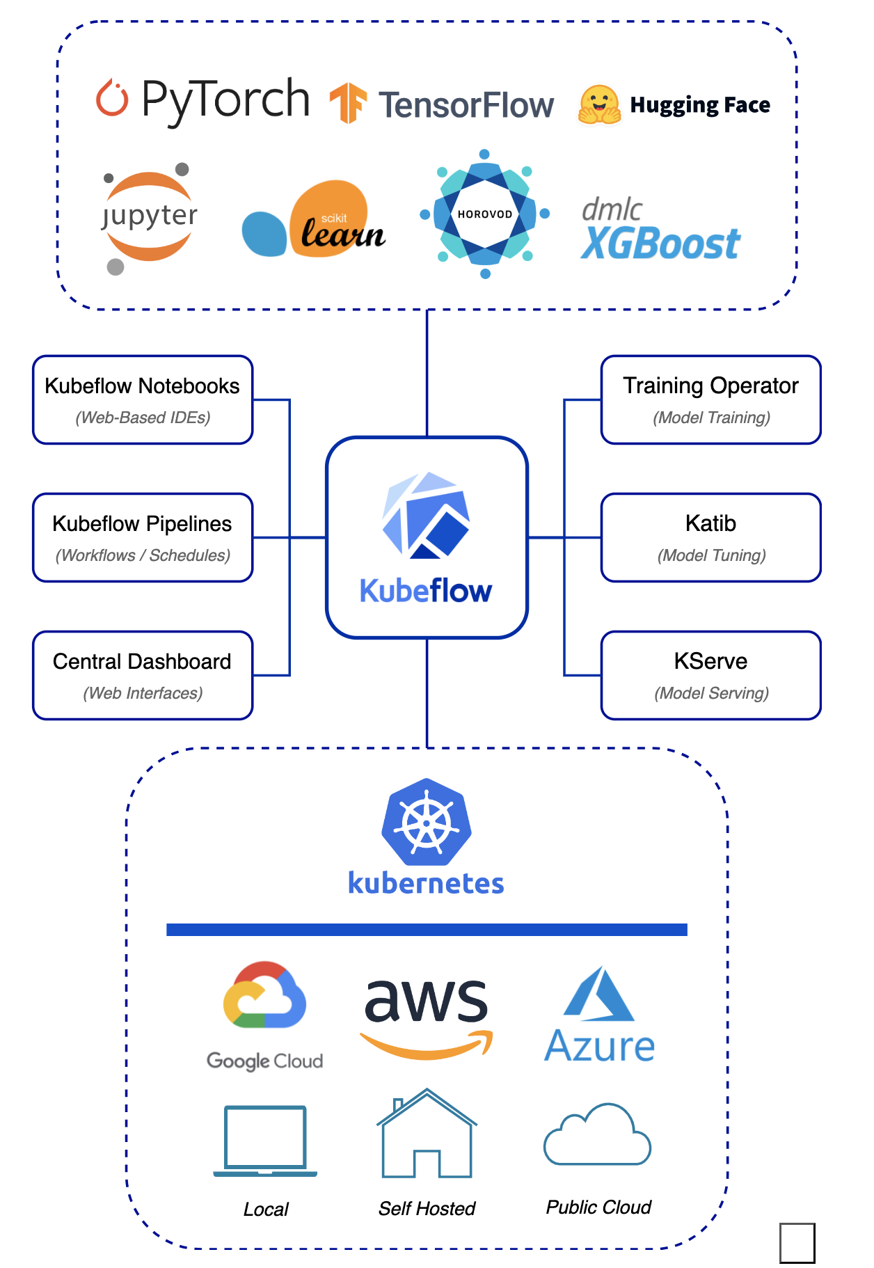
Training
Take advantage of k8s-based solutions

Slide 14
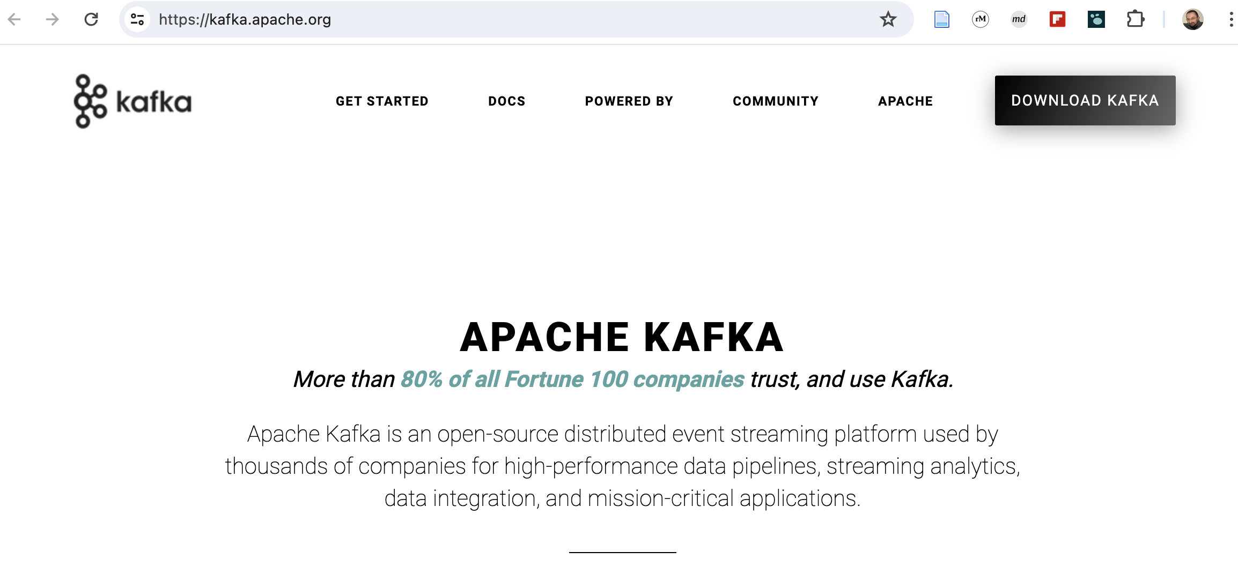
Deployment
Take care of input pipeline management (feature transformation, stream management, etc.)

Slide 15
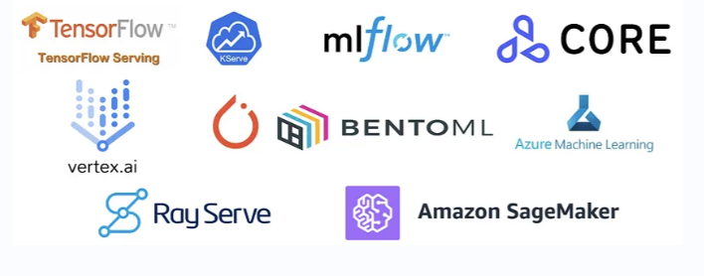
Deployment
Use professional systems to share and serve

Slide 16

Deployment
API
Take advantage of serverless solutions

Slide 17
Deployment
Take advantage of k8s-based solutions

